Slide 1
Foundations of Cryptography conditional probability, perfect secrecy
LiangFeng Zhang
zhanglf@shanghaitech.edu.cn
SIST, ShanghaiTech, 2019F

Slide 2
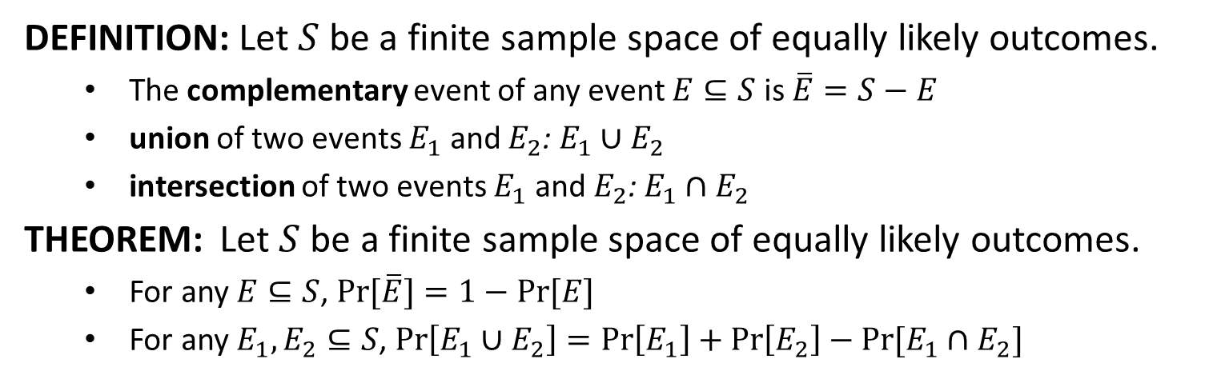
Finite Probability
DEFINITION: Let $S$ be a finite sample space of equally likely outcomes.
The complementary event of any event $E⊆S$ is $\overline{E}=S−E$
union of two events $E_{1}$ and $E_{2}$: $E_{1}∪E_{2}$
intersection of two events $E_{1}$ and $E_{2}$: $E_{1}∩E_{2}$
THEOREM: Let $S$ be a finite sample space of equally likely outcomes.
For any $E⊆S$, $\operatorname{Pr}{[\overline{E}}]=1−Pr⁡[E]$
For any $E_{1}, E_{2}⊆S$, $\operatorname{Pr}\left[E_{1}∪E_{2}\right]=\operatorname{Pr}\left[E_{1}\right]+\operatorname{Pr}\left[E_{2}\right]−Pr⁡[E_{1}∩E_{2}]$

Slide 3
Discrete Probability
Discrete Probability: The sample space is finite or countable
toss a coin until a head appears, sample space $S=\{1,01,001,…\}$
Assigning Probabilities: generalization of finite probability
$S$ is a sample space with a finite or countable number of outcomes.
$Pr⁡[s]$: the probability of any outcome $s∈S$.
$0≤\operatorname{Pr}\left[s\right]≤1$ for any $s∈S$
$\sum_{s∈S}{\operatorname{Pr}\left[s\right]=1}$
Probability Distribution: a function $\{\left(s,\operatorname{Pr}{[s]}\right):s∈S\}$
Uniform distribution: $\left|S\right|=n$ and $\operatorname{Pr}\left[s\right]=1/n$ for all $s∈S$
Choose an element of $S$ at random: choose an element from$S$with the uniform distribution

Slide 4
Discrete Probability
Probability of an Event:
$S$ is a sample space with a finite or countable number of outcomes.
$E⊆S$ is an event
$\operatorname{Pr}\left[E\right]=\sum_{s∈E}{Pr⁡[s]}$
THEOREM: Let $S$ be a finite or countable sample space.
For any $E⊆S$, $\operatorname{Pr}{[\overline{E}}]=1−Pr⁡[E]$
For any $E_{1}, E_{2}⊆S$, $\operatorname{Pr}\left[E_{1}∪E_{2}\right]=\operatorname{Pr}\left[E_{1}\right]+\operatorname{Pr}\left[E_{2}\right]−Pr⁡[E_{1}∩E_{2}]$
union bound: $\operatorname{Pr}\left[E_{1}∪E_{2}\right]≤\operatorname{Pr}\left[E_{1}\right]+Pr⁡[E_{2}]$
can be generalized to multiple events
disjoint events: $\operatorname{Pr}\left[E_{1}∩E_{2}\right]=0$
$\operatorname{Pr}\left[∪_{i} E_{i}\right]=\sum_{i}{Pr⁡[E_{i}]}$for a sequence $E_{1},E_{2},…$ of pairwise disjoint events

Slide 5
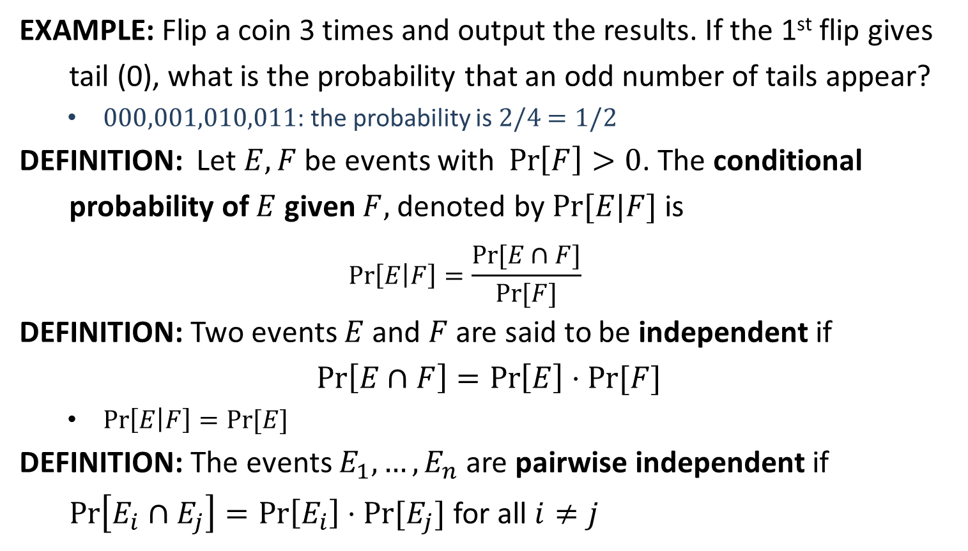
Conditional Probability
EXAMPLE: Flip a coin 3 times and output the results. If the 1st flip gives
tail (0), what is the probability that an odd number of tails appear?
$000,001,010,011$: the probability is $2/4$ $=1/2$
DEFINITION: Let $E,F$ be events with $\operatorname{Pr}\left[F\right]>0$. The conditional
probability of $E$ given $F,$ denoted by $Pr⁡[E|F]$ is
$$\operatorname{Pr}\left[E | F\right]=\frac{Pr⁡[E∩F]}{Pr⁡[F]}$$
DEFINITION: Two events $E$ and $F$ are said to be independent if
$$\operatorname{Pr}\left[E∩F\right]=\operatorname{Pr}\left[E\right]⋅Pr⁡[F]$$
$\operatorname{Pr}\left[E | F\right]=Pr⁡[E]$
DEFINITION: The events $E_{1},…,E_{n}$ are pairwise independent if
$\operatorname{Pr}\left[E_{i}∩E_{j}\right]=\operatorname{Pr}\left[E_{i}\right]⋅Pr⁡[E_{j}]$ for all $i≠j$

Slide 6
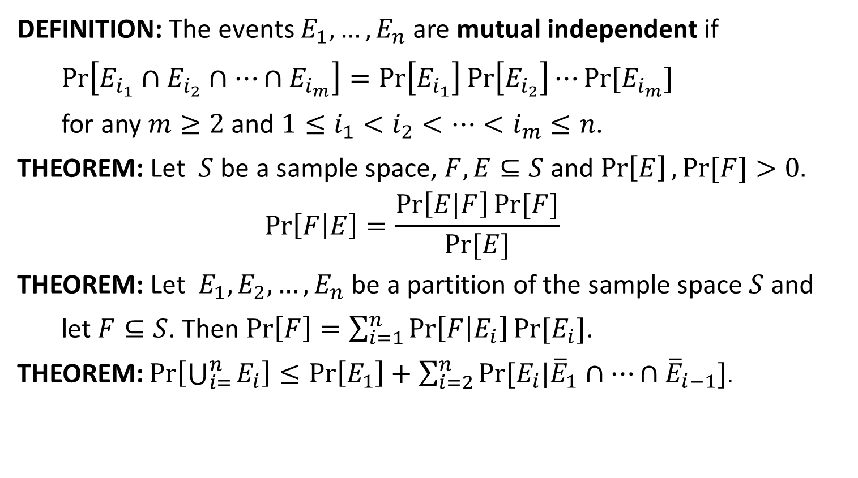
Conditional Probability
DEFINITION: The events $E_{1},…,E_{n}$ are mutual independent if
$\operatorname{Pr}\left[E_{i_{1}}∩E_{i_{2}}∩⋯∩E_{i_{m}}\right]=\operatorname{Pr}\left[E_{i_{1}}\right]\operatorname{Pr}\left[E_{i_{2}}\right]⋯Pr⁡[E_{i_{m}}]$
for any $m≥2$ and $1≤i_{1}<i_{2}<⋯<i_{m}≤n$.
THEOREM: Let $S$ be a sample space, $F,E⊆S$ and $\operatorname{Pr}\left[E\right],Pr⁡[F]>0.$
$$\operatorname{Pr}\left[F | E\right]=\frac{\operatorname{Pr}\left[E|F\right]Pr⁡[F]}{Pr⁡[E]}$$
THEOREM: Let $E_{1},E_{2},…,E_{n}$ be a partition of the sample space $S$ and
let $F⊆S$. Then $\operatorname{Pr}\left[F\right]=\sum_{i=1}^{n}{\operatorname{Pr}\left[F | E_{i}\right]Pr⁡[E_{i}]}$.
THEOREM: $\operatorname{Pr}\left[\bigcup_{i=}^{n}{E_{i}}\right]≤\operatorname{Pr}\left[E_{1}\right]+\sum_{i=2}^{n}{Pr⁡[E_{i}|{\overline{E}}_{1}∩⋯∩{\overline{E}}_{i−1}]}$.

Slide 7
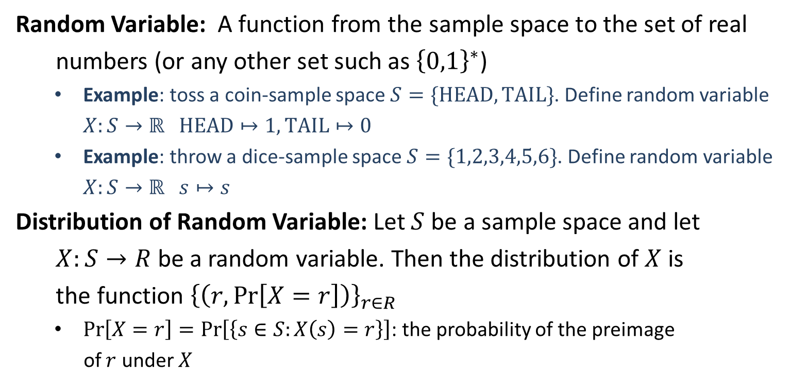
Random Variable
Random Variable: A function from the sample space to the set of real
numbers (or any other set such as ${\left\{0,1\right\}}^{∗}$)
Example: toss a coin-sample space $S=\{HEAD, TAIL\}$. Define random variable $X:S→ℝ$ $HEAD↦1, TAIL↦0$
Example: throw a dice-sample space $S=\{1,2,3,4,5,6\}$. Define random variable $X:S→ℝ$ $s↦s$
Distribution of Random Variable: Let $S$ be a sample space and let
$X:S→R$ be a random variable. Then the distribution of $X$ is
the function ${\left\{\left(r,\operatorname{Pr}\left[X=r\right]\right)\right\}}_{r∈R}$
$\operatorname{Pr}\left[X=r\right]=\operatorname{Pr}\left[\left\{s∈S:X\left(s\right)=r\right\}\right]$: the probability of the preimage
of $r$ under $X$

Slide 8
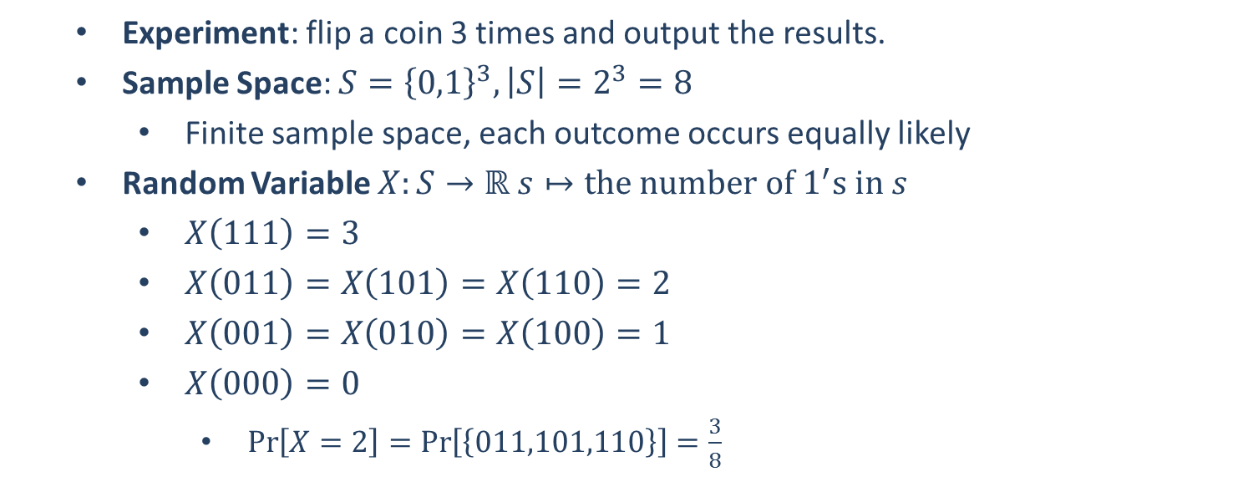
Example
Experiment: flip a coin 3 times and output the results.
Sample Space: $S={\left\{0,1\right\}}^{3}, \left|S\right|=2^{3}=8$
Finite sample space, each outcome occurs equally likely
Random Variable $X:S→ℝ s↦the number of 1^{′}s in s$
$X\left(111\right)=3$
$X\left(011\right)=X\left(101\right)=X\left(110\right)=2$
$X\left(001\right)=X\left(010\right)=X\left(100\right)=1$
$X\left(000\right)=0$
$\operatorname{Pr}\left[X=2\right]=\operatorname{Pr}\left[\left\{011,101,110\right\}\right]=\frac{3}{8}$

Slide 10







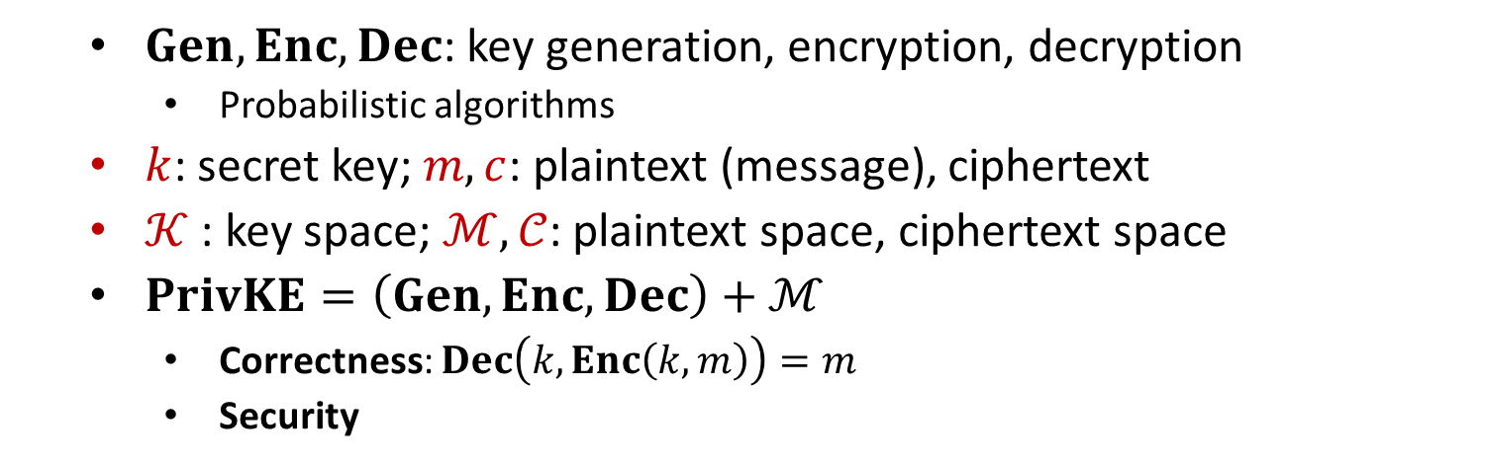



Private-Key Encryption
$$m$$
$$Enc$$
$$Enc(k, m)=c$$
$$Dec$$
Alice
Bob
$$k$$
$$k$$
$$Dec(k, c)=m$$
$$Gen$$
$Gen, Enc, Dec$: key generation, encryption, decryption
Probabilistic algorithms
$k$: secret key; $m, c$: plaintext (message), ciphertext
$𝒦$ : key space; $ℳ,𝒞$: plaintext space, ciphertext space
$PrivKE=\left(Gen, Enc, Dec\right)+ℳ$
Correctness: $Dec\left(k,Enc\left(k,m\right)\right)=m$
Security

Slide 11
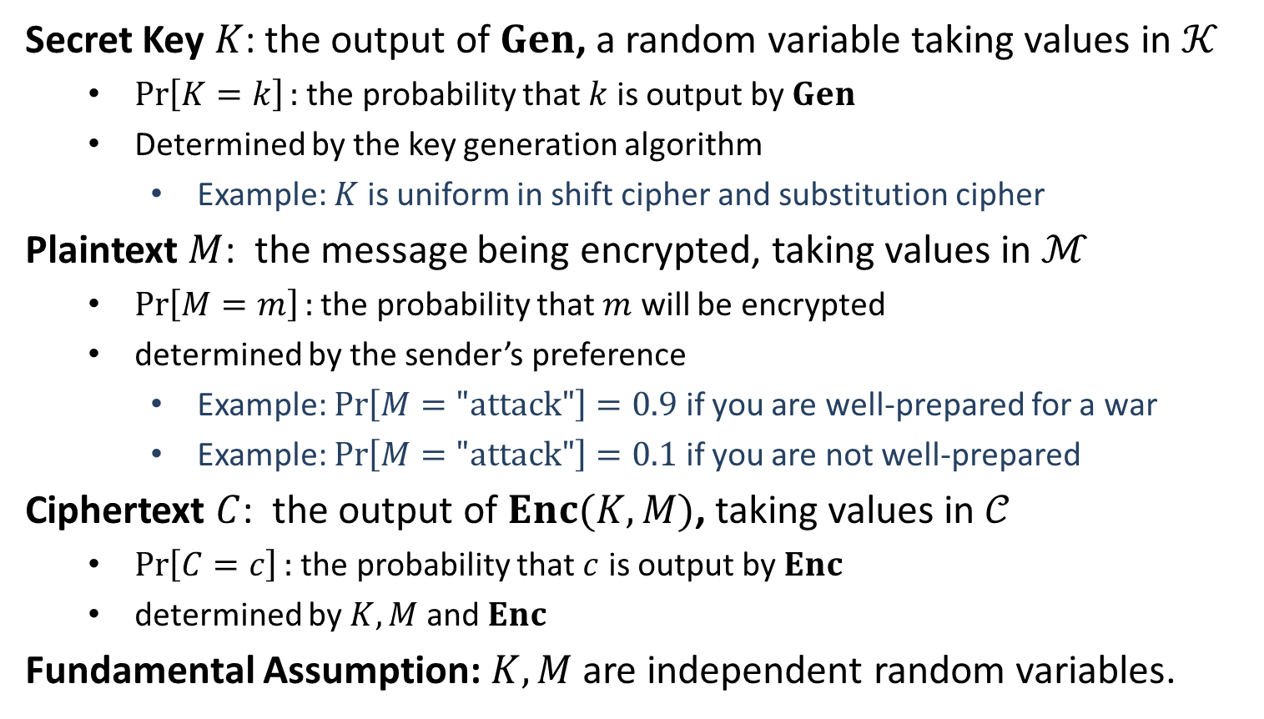
Distributions on $𝒦,ℳ,𝒞$
Secret Key $K$: the output of $Gen$, a random variable taking values in $𝒦$
$\operatorname{Pr}\left[K=k\right]:$ the probability that $k$ is output by $Gen$
Determined by the key generation algorithm
Example: $K$ is uniform in shift cipher and substitution cipher
Plaintext $M$: the message being encrypted, taking values in $ℳ$
$\operatorname{Pr}\left[M=m\right]:$ the probability that $m$ will be encrypted
determined by the sender’s preference
Example: $\operatorname{Pr}\left[M="\text{attack}"\right]=0.9$ if you are well-prepared for a war
Example: $\operatorname{Pr}\left[M="\text{attack}"\right]=0.1$ if you are not well-prepared
Ciphertext $C$: the output of $Enc(K,M)$, taking values in $𝒞$
$\operatorname{Pr}\left[C=c\right]:$ the probability that $c$ is output by $Enc$
determined by $K,M$ and $Enc$
Fundamental Assumption: $K,M$ are independent random variables.

Slide 12
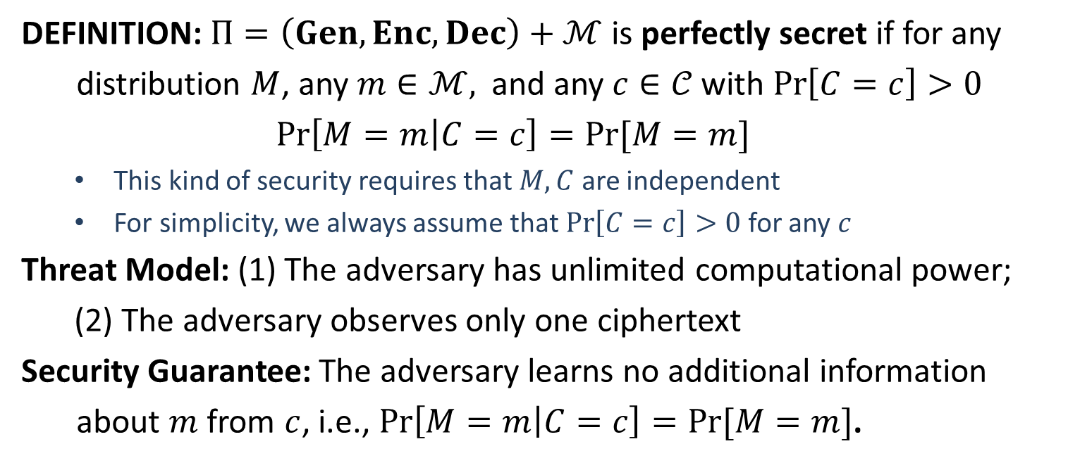
Perfect Secrecy
DEFINITION: $Π=\left(Gen, Enc, Dec\right)+ℳ$ is perfectly secret if for any
distribution $M$, any $m∈ℳ,$ and any $c∈𝒞$with $\operatorname{Pr}\left[C=c\right]>0$
$$\operatorname{Pr}\left[M=m | C=c\right]=Pr⁡[M=m]$$
This kind of security requires that $M,C$ are independent
For simplicity, we always assume that $\operatorname{Pr}\left[C=c\right]>0$ for any $c$
Threat Model: (1) The adversary has unlimited computational power;
(2) The adversary observes only one ciphertext
Security Guarantee: The adversary learns no additional information
about $m$ from $c$, i.e., $\operatorname{Pr}\left[M=m | C=c\right]=Pr⁡[M=m]$.

Slide 13
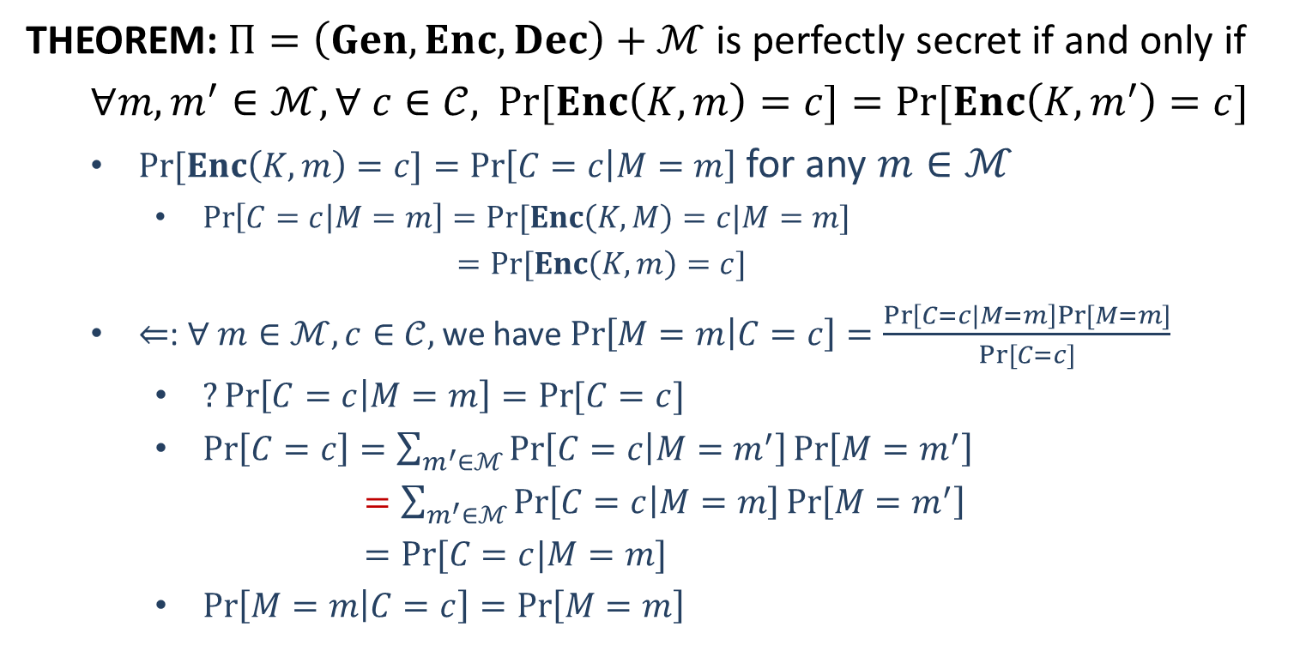
Perfect Secrecy
THEOREM: $Π=\left(Gen, Enc, Dec\right)+ℳ$ is perfectly secret if and only if
$∀m, m^{′}∈ℳ, ∀ c∈𝒞,$ $\operatorname{Pr}{[Enc\left(K,m\right)=c]}=Pr⁡[Enc\left(K,m^{′}\right)=c]$
$\operatorname{Pr}{[Enc\left(K,m\right)=c]}=\operatorname{Pr}\left[C=c | M=m\right]$ for any $m∈ℳ$
$\operatorname{Pr}\left[C=c | M=m\right]=Pr⁡[Enc\left(K,M\right)=c|M=m]$
$=Pr⁡[Enc\left(K,m\right)=c]$
$⇐$: $∀ m∈ℳ, c∈𝒞,$ we have $\operatorname{Pr}\left[M=m | C=c\right]=\frac{\operatorname{Pr}\left[C=c|M=m\right]Pr⁡[M=m]}{Pr⁡[C=c]}$
$?\operatorname{Pr}\left[C=c | M=m\right]=\operatorname{Pr}{[C=c]}$
$\operatorname{Pr}\left[C=c\right]=\sum_{m^{′}∈ℳ}{\operatorname{Pr}\left[C=c | M=m^{′}\right]\operatorname{Pr}\left[M=m^{′}\right]}$
$=\sum_{m^{′}∈ℳ}{\operatorname{Pr}\left[C=c | M=m\right]\operatorname{Pr}\left[M=m^{′}\right]}$
$=Pr⁡[C=c|M=m]$
$\operatorname{Pr}\left[M=m | C=c\right]=\operatorname{Pr}\left[M=m\right]$

Slide 14
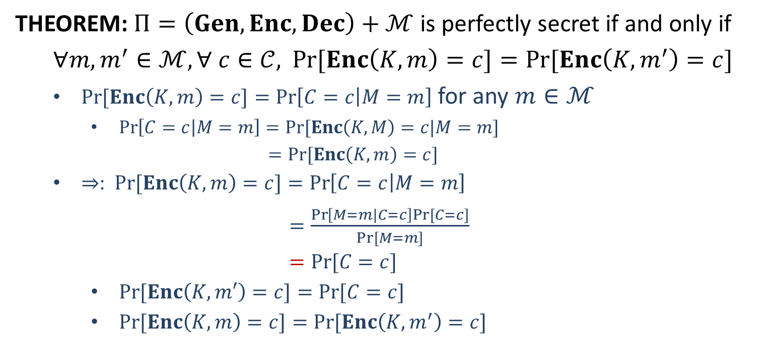
Perfect Secrecy
THEOREM: $Π=\left(Gen, Enc, Dec\right)+ℳ$ is perfectly secret if and only if
$∀m, m^{′}∈ℳ, ∀ c∈𝒞,$ $\operatorname{Pr}{[Enc\left(K,m\right)=c]}=Pr⁡[Enc\left(K,m^{′}\right)=c]$
$\operatorname{Pr}{[Enc\left(K,m\right)=c]}=\operatorname{Pr}\left[C=c | M=m\right]$ for any $m∈ℳ$
$\operatorname{Pr}\left[C=c | M=m\right]=Pr⁡[Enc\left(K,M\right)=c|M=m]$
$=Pr⁡[Enc\left(K,m\right)=c]$
$⇒$: $\operatorname{Pr}{[Enc\left(K,m\right)=c]}=\operatorname{Pr}\left[C=c | M=m\right]$
$=\frac{\operatorname{Pr}\left[M=m|C=c\right]Pr⁡[C=c]}{Pr⁡[M=m]}$
$=Pr⁡[C=c]$
$\operatorname{Pr}{[Enc\left(K,m′\right)=c]}=Pr⁡[C=c]$
$\operatorname{Pr}{[Enc\left(K,m\right)=c]}=Pr⁡[Enc\left(K,m^{′}\right)=c]$

Slide 16


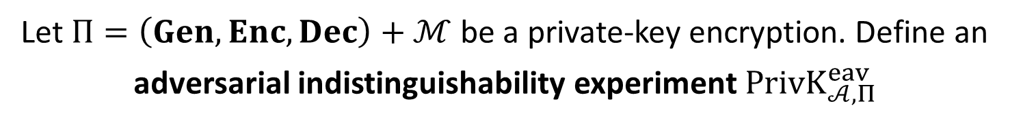



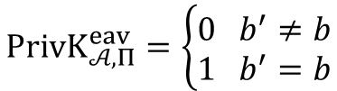





Perfect Indistinguishability
Let $Π=\left(Gen, Enc, Dec\right)+ℳ$ be a private-key encryption. Define an
adversarial indistinguishability experiment $PrivK_{𝒜, Π}^{eav}$
choose $m_{0}, m_{1}∈ ℳ$
$$m_{0},m_{1}$$
$$k←Gen$$
$$b←\{0,1\}$$
$$Challenger$$
$$c←Enc(k,m_{b})$$
$$c$$
$$Adversary 𝒜$$
$$b′$$
$$PrivK_{𝒜, Π}^{eav}=\left\{\begin{aligned}0 b^{′}≠b \\ 1 b^{′}=b\end{aligned}\right.$$
DEFINITION: $Π$is perfectly indistinguishable if for every adversary $𝒜$,
$$\operatorname{Pr}\left[PrivK_{𝒜, Π}^{eav}=1\right]=1/2$$

